Slide 1
CS174A Group 11
Final Project
Erin Zhu 105329609
Kandrex Millones 305424120
Rahul Madnawat 105563782

Slide 2
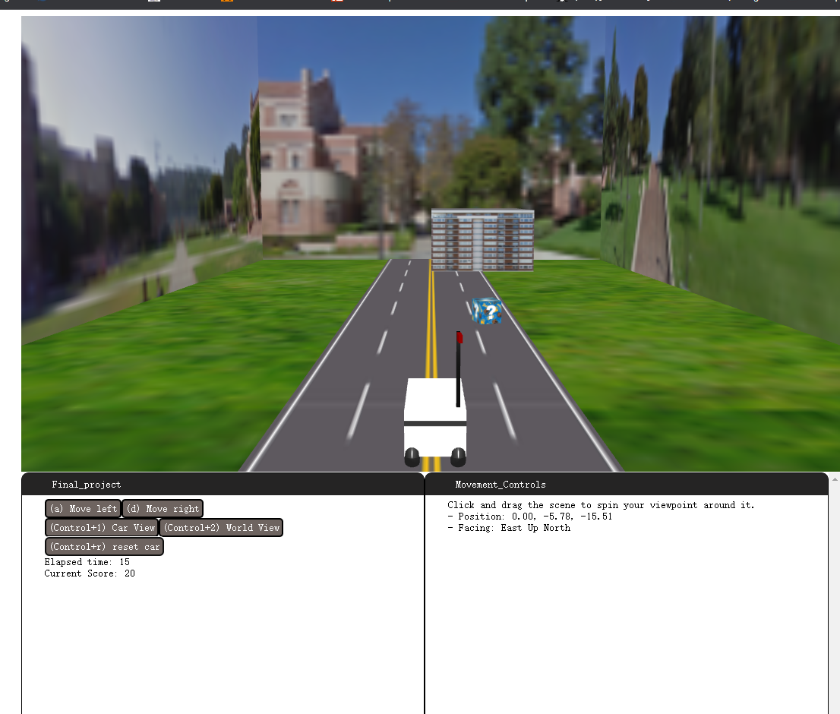
BruinKart
Add score when hit a prize
Fail when hit an obstacle (building)
Collision Detection

Slide 3
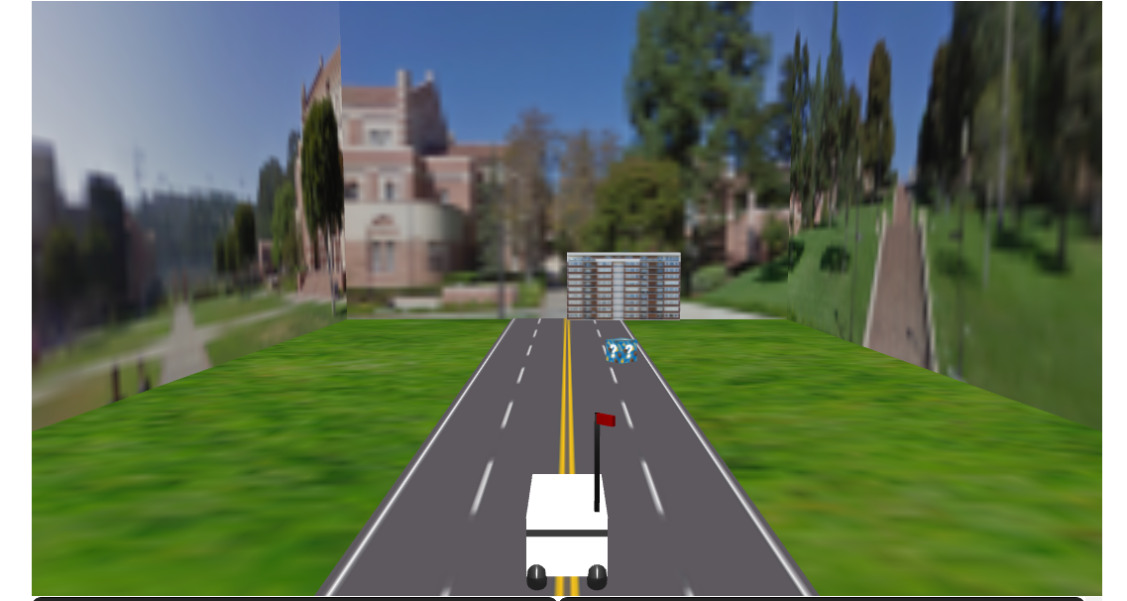
Features
Car does not move
The texture of backgrounds move and objects moves toward the car
The flag on the car rotates as the car moves

Slide 4
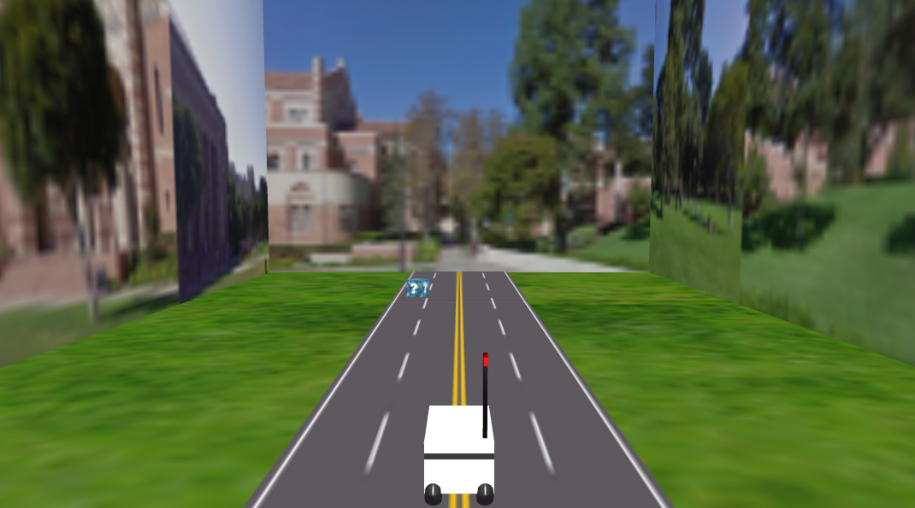
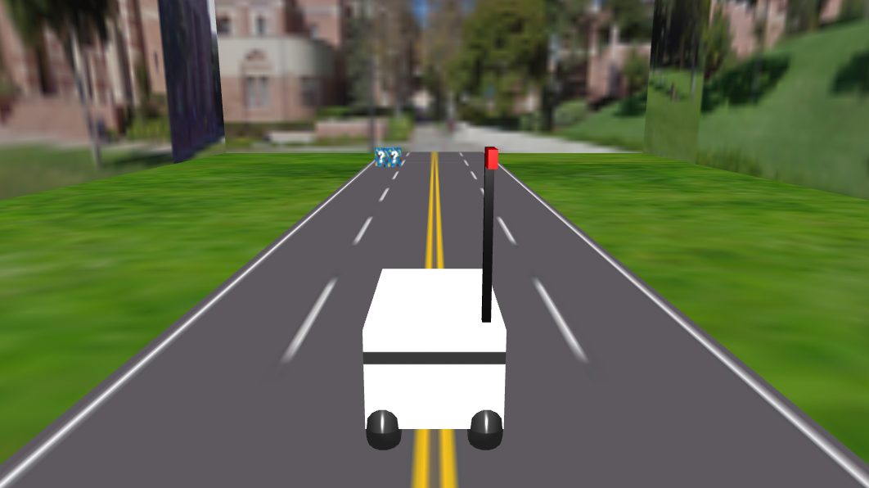
Features
Moves through keyboard input: A for left, D for right
Two camera views: Car view (moves with car) (Ctrl + 1) and World view (Ctrl + 2)
Reset game (Ctrl + r)

Slide 5
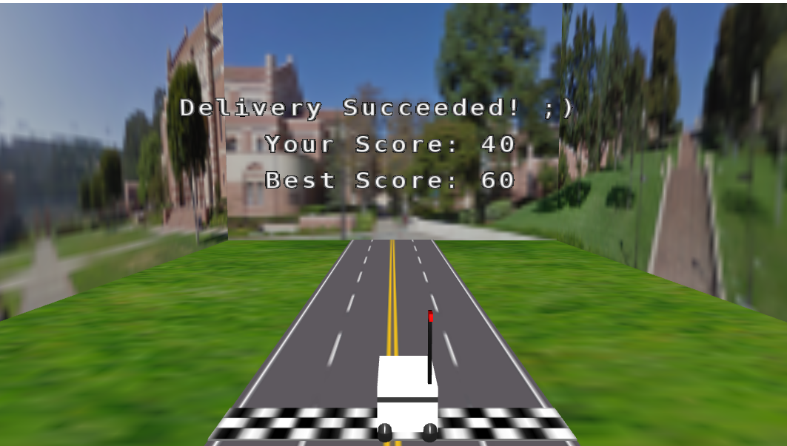
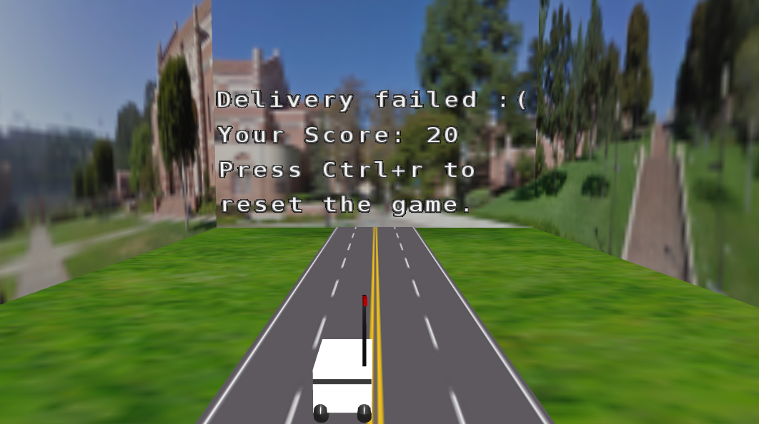
Features
Result displayed at the end of game

Slide 6
Demo

